Slide 1
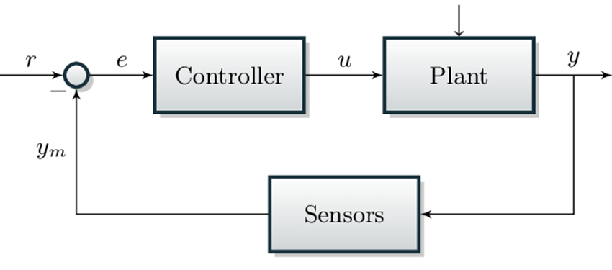
L8 Control
Zonghua Gu
Fall 2026

Slide 2
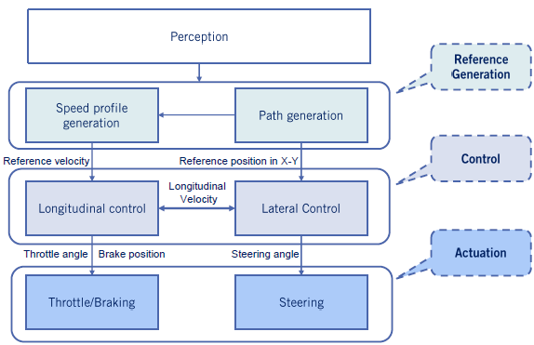
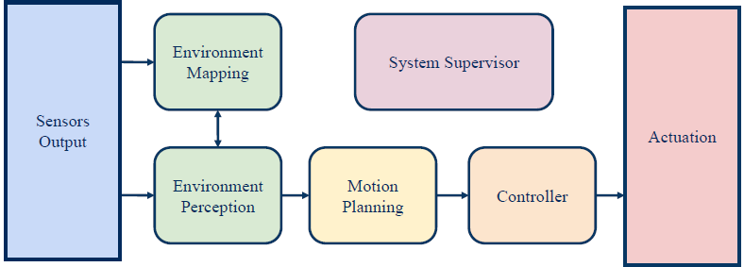
Control in the AD Pipeline
The controller outputs control commands (brake, acceleration, steering) to follow the trajectory output from motion planning
(Local Planning)

Slide 3
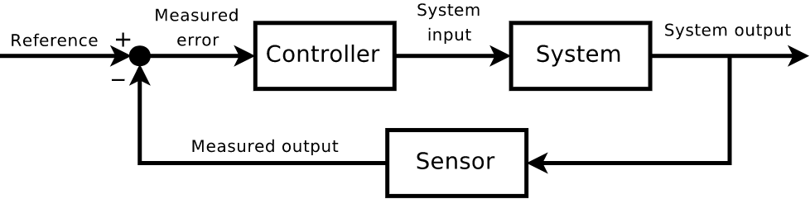
Feedback Control Problem
Given a system and a reference signal, find a control law such that the closed loop system is stable and follows the reference signal
The most common control algorithms in automotive systems are Proportional–Integral–Derivative (PID) and Model Predictive Control (MPC)

Slide 4
Outline
PID Control
LQR (Linear Quadratic Regulator)
MPC Control
Kinematic bicycle model
Geometric path tracking: Pure Pursuit & Stanley
Twiddle() for PID control tuning

Slide 5
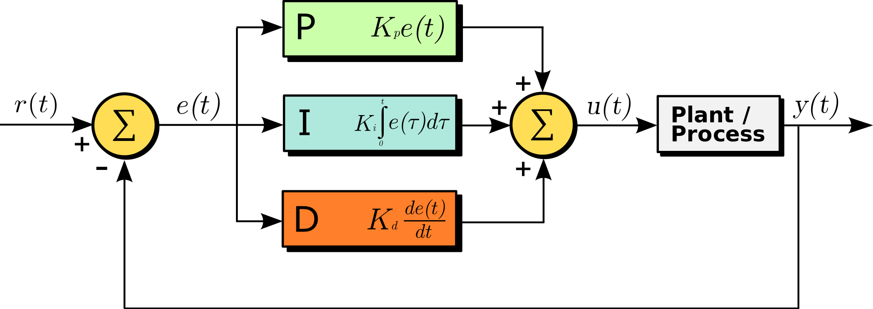

PID Control
Tracking Error: $e\left(t\right)=r\left(t\right)−y(t)$
Control input: $u\left(t\right)=K_{p}e\left(t\right)+K_{i}\int_{0}^{t}{e\left(τ\right)dτ}+K_{d}\dot{e}(t)$
Ref: Controlling Self Driving Cars
  https://www.youtube.com/watch?v=4Y7zG48uHRo
https://en.wikipedia.org/wiki/PID_controller

Slide 6
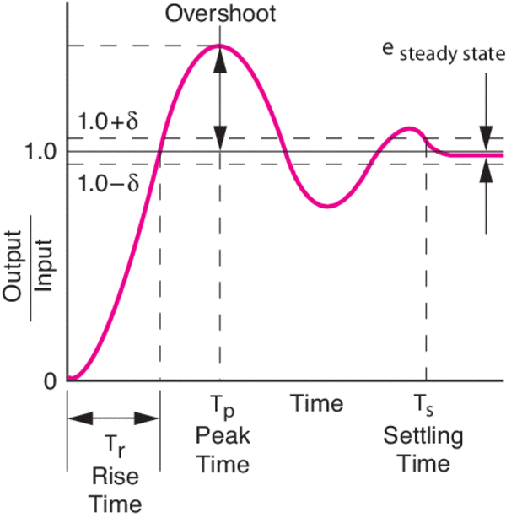
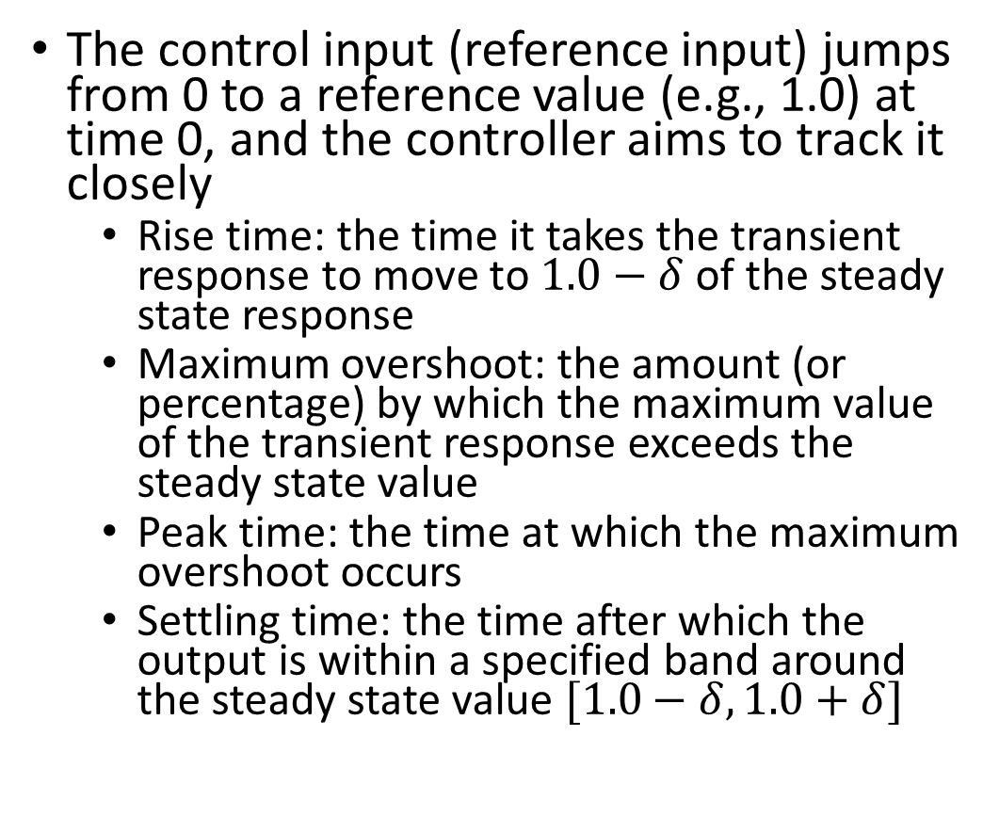
Step Response Performance Metrics
The control input (reference input) jumps from 0 to a reference value (e.g., 1.0) at time 0, and the controller aims to track it closely
  Rise time: the time it takes the transient response to move to $1.0−δ$ of the steady state response
  Maximum overshoot: the amount (or percentage) by which the maximum value of the transient response exceeds the steady state value
  Peak time: the time at which the maximum overshoot occurs
  Settling time: the time after which the output is within a specified band around the steady state value $[1.0−δ, 1.0+δ]$
https://www.newport.com/n/control-theory-terminology
Notes:
https://www.maplesoft.com/content/EngineeringFundamentals/11/MapleDocument_11/Block%20Diagrams,%20Feedback%20and%20Transient%20Response%20Specifications.pdf
Note: rise time is defined here as the time to reach 1−δ of the steady-state value (as in the figure); many textbooks use the 10%–90% rise time instead.

Slide 7
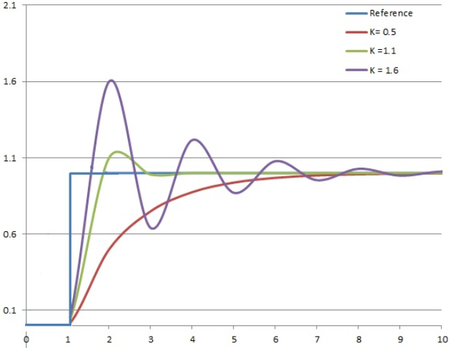
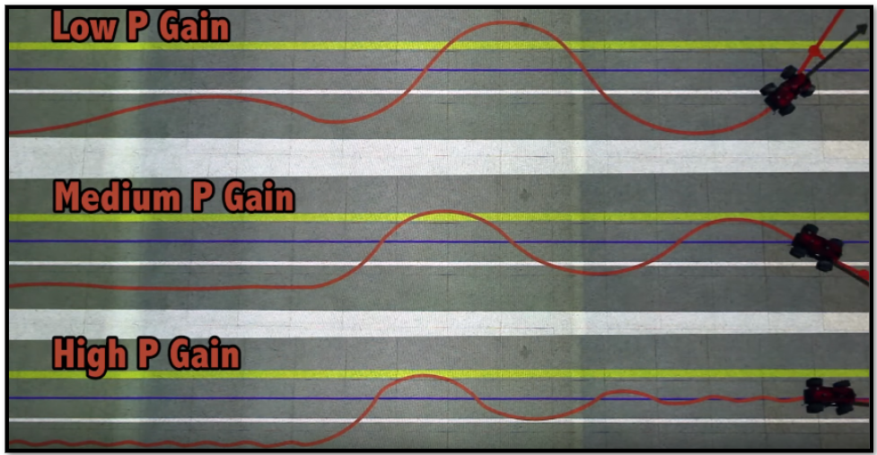
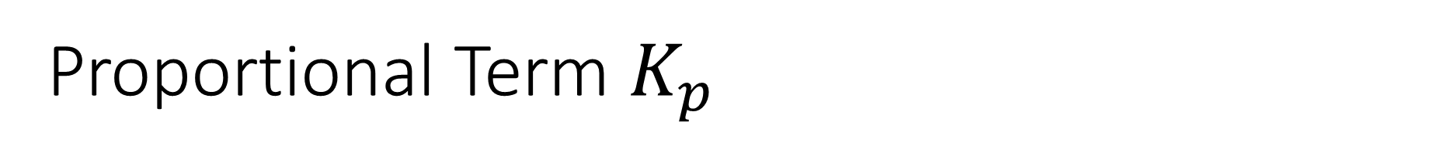
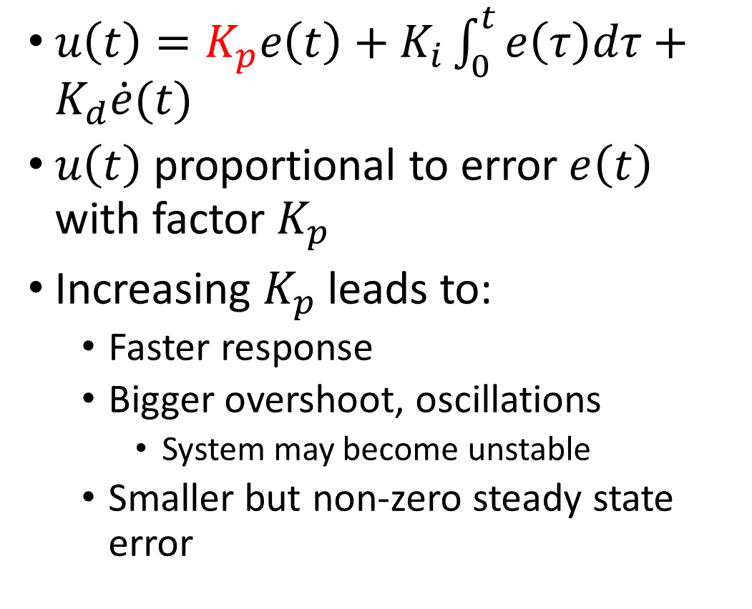
Proportional Term $K_{p}$
$u\left(t\right)=K_{p}e\left(t\right)+K_{i}\int_{0}^{t}{e\left(τ\right)dτ}+K_{d}\dot{e}(t)$
$u\left(t\right)$ proportional to error $e\left(t\right)$ with factor $K_{p}$
Increasing $K_{p}$ leads to:
  Faster response
  Bigger overshoot, oscillations
    System may become unstable
  Smaller but non-zero steady state error

Slide 8
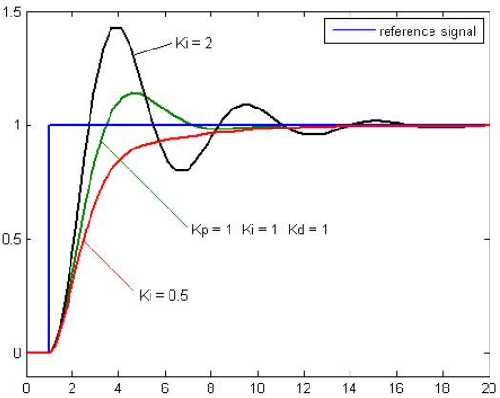
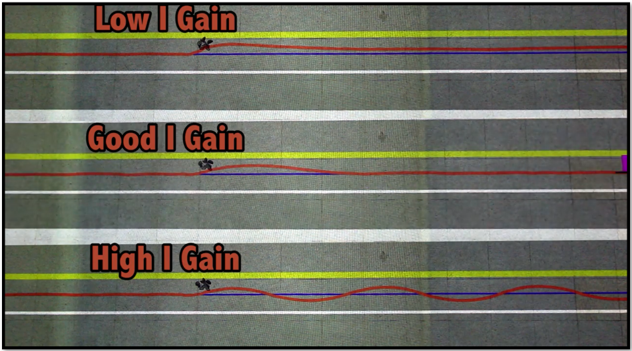

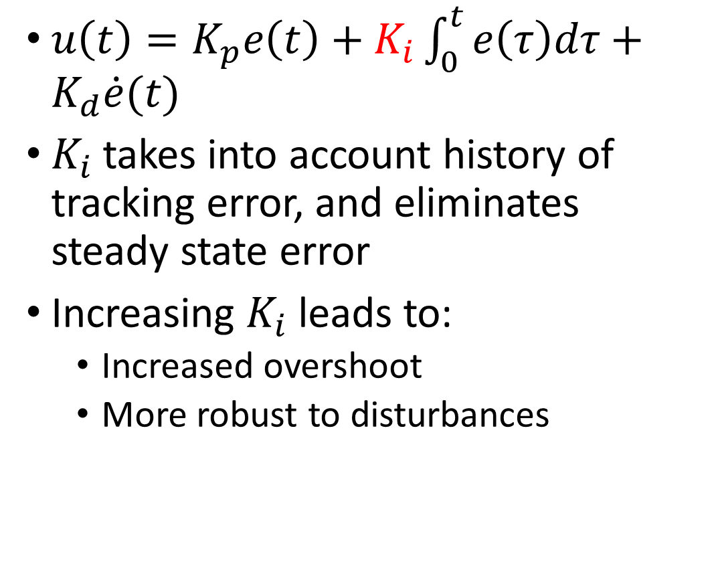
Integral Term $K_{i}$
$u\left(t\right)=K_{p}e\left(t\right)+K_{i}\int_{0}^{t}{e\left(τ\right)dτ}+K_{d}\dot{e}(t)$
$K_{i}$takes into account history of tracking error, and eliminates steady state error
Increasing $K_{i}$ leads to:
  Increased overshoot
  More robust to disturbances

Slide 9
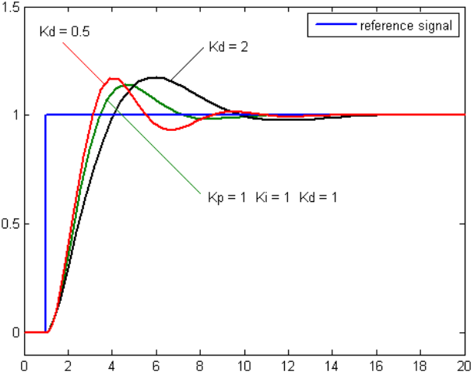
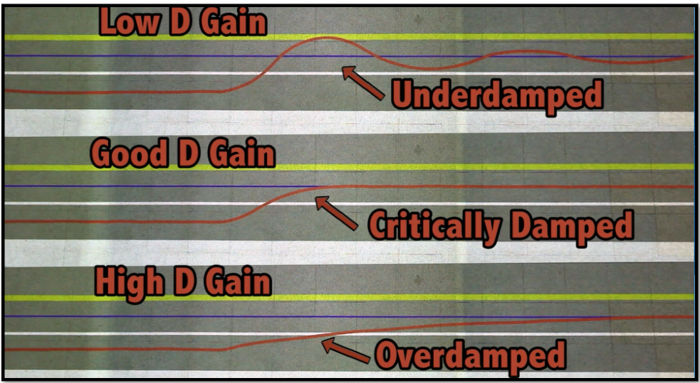
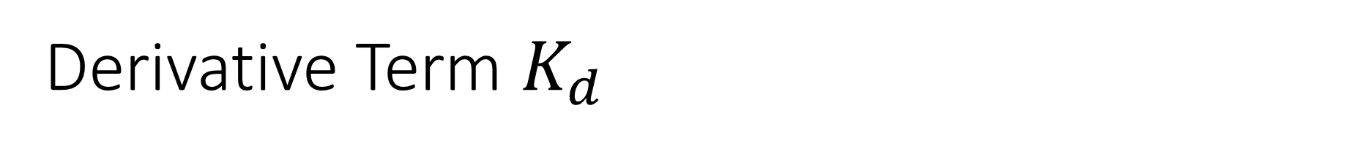
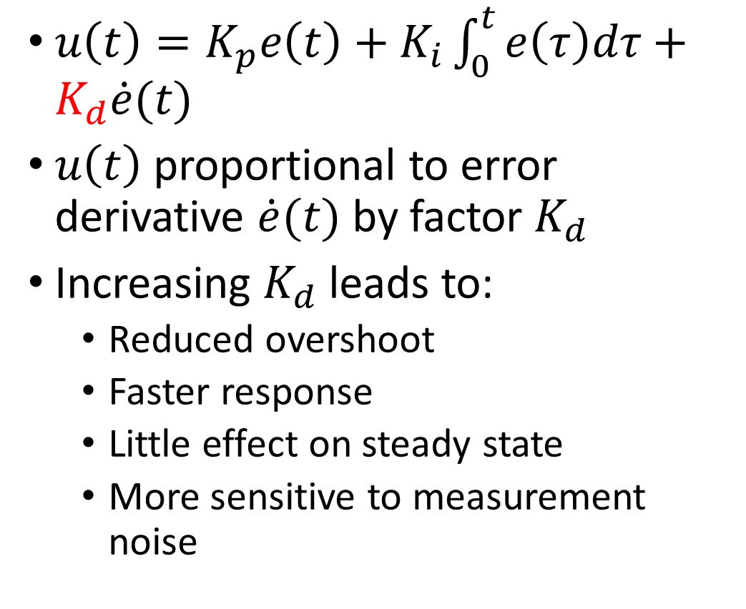
Derivative Term $K_{d}$
$u\left(t\right)=K_{p}e\left(t\right)+K_{i}\int_{0}^{t}{e\left(τ\right)dτ}+K_{d}\dot{e}(t)$
$u\left(t\right)$ proportional to error derivative $\dot{e}(t)$ by factor $K_{d}$
Increasing $K_{d}$ leads to:
  Reduced overshoot
  Faster response
  Little effect on steady state
  More sensitive to measurement noise

Slide 10

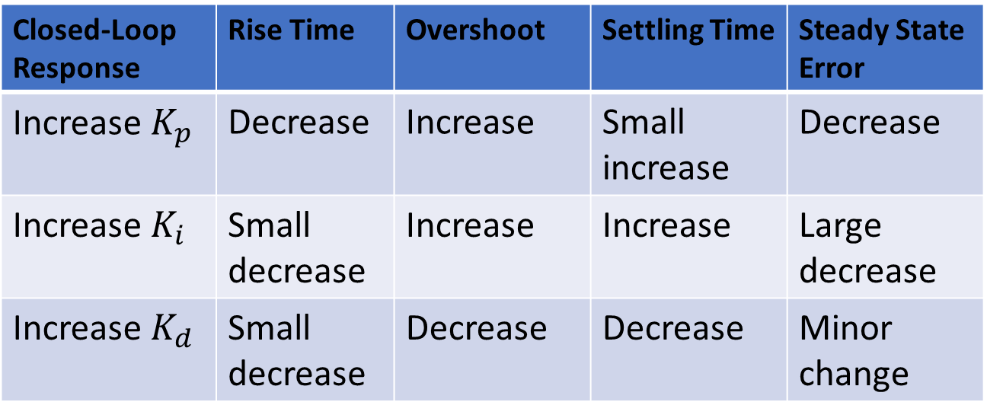
Effects of PID Gains
$u\left(t\right)=K_{p}e\left(t\right)+K_{i}\int_{0}^{t}{e\left(τ\right)dτ}+K_{d}\dot{e}(t)$
Closed-Loop Response | Rise Time | Overshoot | Settling Time | Steady State Error
Increase $K_{p}$ | Decrease | Increase | Small increase | Decrease
Increase $K_{i}$ | Small decrease | Increase | Increase | Large decrease
Increase $K_{d}$ | Small decrease | Decrease | Decrease | Minor change

Slide 11
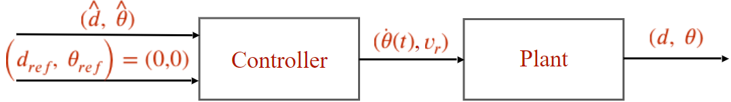
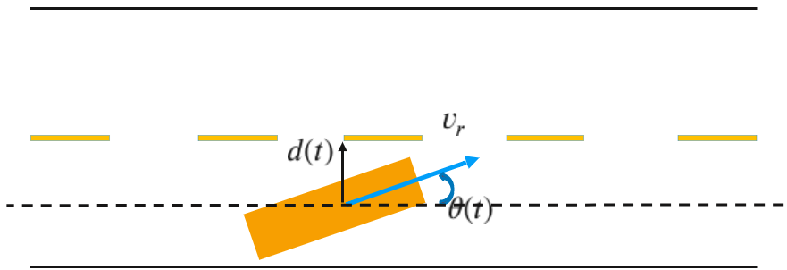
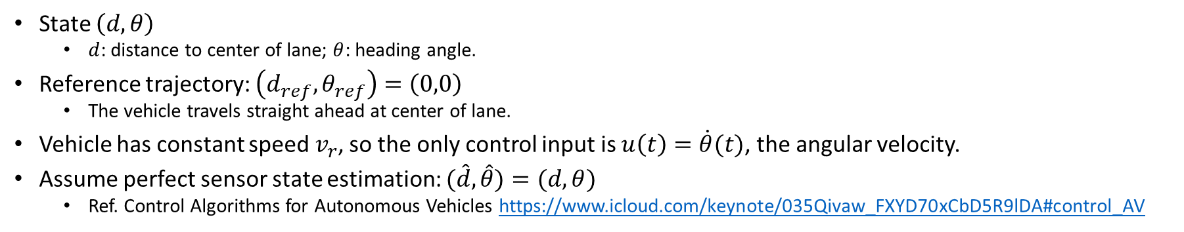
Example: Vehicle Lateral Control
State $\left(d,θ\right)$
  $d$: distance to center of lane; $θ$: heading angle.
Reference trajectory: $\left(d_{ref},θ_{ref}\right)=\left(0,0\right)$
  The vehicle travels straight ahead at center of lane.
Vehicle has constant speed $v_{r}$, so the only control input is $u\left(t\right)=\dot{θ}(t)$, the angular velocity.
Assume perfect sensor state estimation: $(\hat{d}, \hat{θ})=(d, θ)$
  Ref. Control Algorithms for Autonomous Vehicles https://www.icloud.com/keynote/035Qivaw_FXYD70xCbD5R9lDA#control_AV
Notes:
https://www.icloud.com/keynote/035Qivaw_FXYD70xCbD5R9lDA#control_AV
Ref. Control Algorithms for Autonomous Vehicles https://www.icloud.com/keynote/035Qivaw_FXYD70xCbD5R9lDA#control_AV

Slide 12
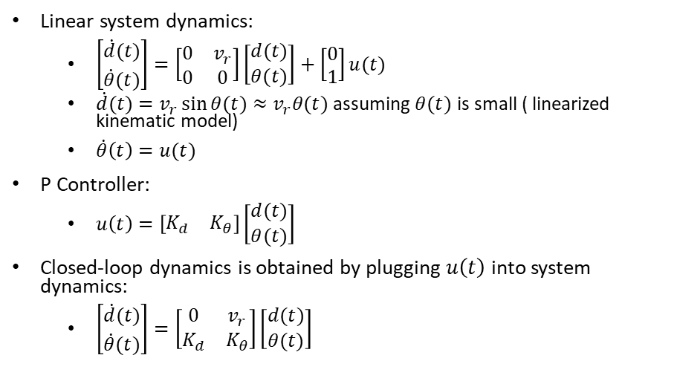
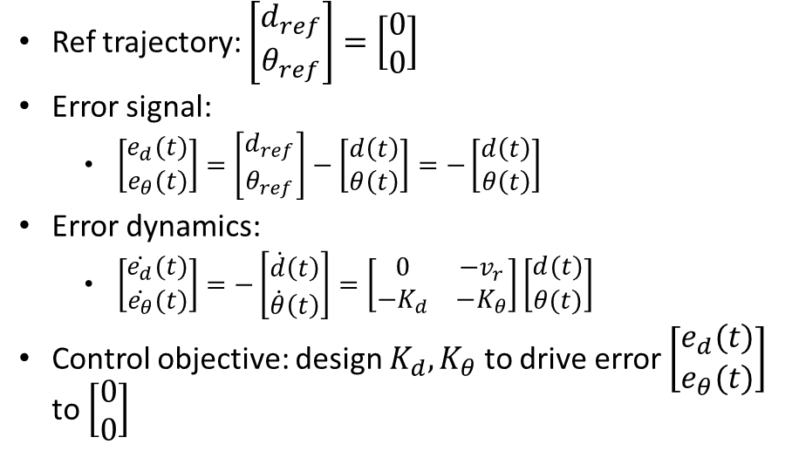
System and P Control Modeling
Linear system dynamics:
  $\left[\begin{matrix}\dot{d}(t) \\ \dot{θ}(t)\end{matrix}\right]=\left[\begin{matrix}0 & v_{r} \\ 0 & 0\end{matrix}\right]\left[\begin{matrix}d(t) \\ θ(t)\end{matrix}\right]+\left[\begin{matrix}0 \\ 1\end{matrix}\right]u(t)$
  $\dot{d}(t)=v_{r}\sin{θ(t)}≈$ $v_{r}θ(t)$ assuming $θ(t)$ is small ( linearized kinematic model)
  $\dot{θ}\left(t\right)=u(t)$
P Controller:
  $u\left(t\right)=\left[\begin{matrix}K_{d} & K_{θ}\end{matrix}\right]\left[\begin{matrix}d(t) \\ θ(t)\end{matrix}\right]$
Closed-loop dynamics is obtained by plugging $u\left(t\right)$ into system dynamics:
  $\left[\begin{matrix}\dot{d}(t) \\ \dot{θ}(t)\end{matrix}\right]=\left[\begin{matrix}0 & v_{r} \\ K_{d} & K_{θ}\end{matrix}\right]\left[\begin{matrix}d(t) \\ θ(t)\end{matrix}\right]$
Ref trajectory: $\left[\begin{matrix}d_{ref} \\ θ_{ref}\end{matrix}\right]=\left[\begin{matrix}0 \\ 0\end{matrix}\right]$
Error signal:
  $\left[\begin{matrix}e_{d}(t) \\ e_{θ}(t)\end{matrix}\right]=\left[\begin{matrix}d_{ref} \\ θ_{ref}\end{matrix}\right]−\left[\begin{matrix}d\left(t\right) \\ θ\left(t\right)\end{matrix}\right]=−\left[\begin{matrix}d\left(t\right) \\ θ\left(t\right)\end{matrix}\right]$
Error dynamics:
  $\left[\begin{matrix}\dot{e_{d}}(t) \\ \dot{e_{θ}}(t)\end{matrix}\right]=−\left[\begin{matrix}\dot{d}\left(t\right) \\ \dot{θ}\left(t\right)\end{matrix}\right]=\left[\begin{matrix}0 & −v_{r} \\ {−K}_{d} & {−K}_{θ}\end{matrix}\right]\left[\begin{matrix}d(t) \\ θ(t)\end{matrix}\right]$
Control objective: design $K_{d},K_{θ}$ to drive error $\left[\begin{matrix}e_{d}(t) \\ e_{θ}(t)\end{matrix}\right]$ to $\left[\begin{matrix}0 \\ 0\end{matrix}\right]$

Slide 13
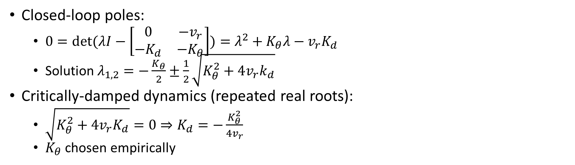
P Control Design with Pole Placement (not covered in this course)
Closed-loop poles:
  $0=\det{(λI−\left[\begin{matrix}0 & v_{r} \\ K_{d} & K_{θ}\end{matrix}\right])}=λ^{2}−K_{θ}λ−v_{r}K_{d}$
  Solution $λ_{1,2}=\frac{K_{θ}}{2}±\frac{1}{2}\sqrt{K_{θ}^{2}+4v_{r}K_{d}}$
Critically-damped dynamics (repeated real roots):
  $\sqrt{K_{θ}^{2}+4v_{r}K_{d}}=0⇒K_{d}=−\frac{K_{θ}^{2}}{4v_{r}}$
  $K_{θ}$ chosen empirically
  Stable closed loop requires $K_{θ}<0$ and $K_{d}<0$ (negative feedback on both $d$ and $θ$)

Slide 14
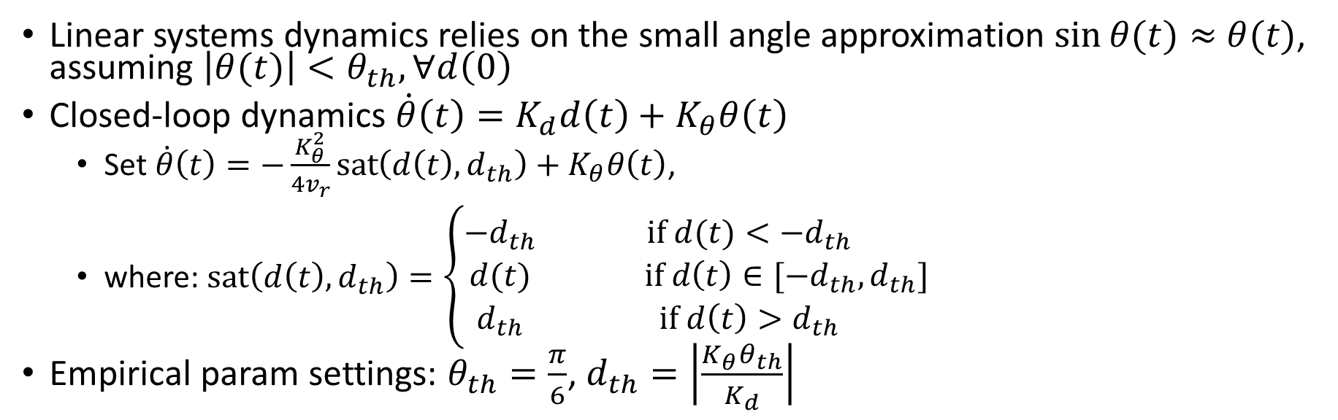
P Control Design Cont’d
Linear systems dynamics relies on the small angle approximation $\sin{θ(t)}≈$ $θ(t)$, assuming $\left|θ(t)\right|<θ_{th},∀d\left(0\right)$
Closed-loop dynamics $\dot{θ}\left(t\right)=K_{d}d\left(t\right)+K_{θ}θ\left(t\right)$
  Set $\dot{θ}\left(t\right)=−\frac{K_{θ}^{2}}{4v_{r}}sat\left(d\left(t\right),d_{th}\right)+K_{θ}θ\left(t\right)$,
  where: $\operatorname{sat}\left(d\left(t\right),d_{th}\right)=\left\{\begin{matrix}−d_{th} & if d(t)<−d_{th} \\ d(t) & if d\left(t\right)∈[−d_{th},d_{th}] \\ d_{th} & if {d\left(t\right)>d}_{th}\end{matrix}\right.$
Empirical param settings: $θ_{th}=\frac{π}{6}$, $d_{th}=\left|\frac{K_{θ}θ_{th}}{K_{d}}\right|$
Notes:
For example: to have $θ_{th}=\frac{π}{6}$, set $d_{th}=\left|\frac{K_{θ}θ_{th}}{K_{d}}\right|$
Even if the vehicle is very far from center of lane, do not change heading angle $θ(t)$ too fast (keep $\dot{θ}\left(t\right)$ small). (A heuristic rule-of-thumb, not a hard guarantee)

Slide 15
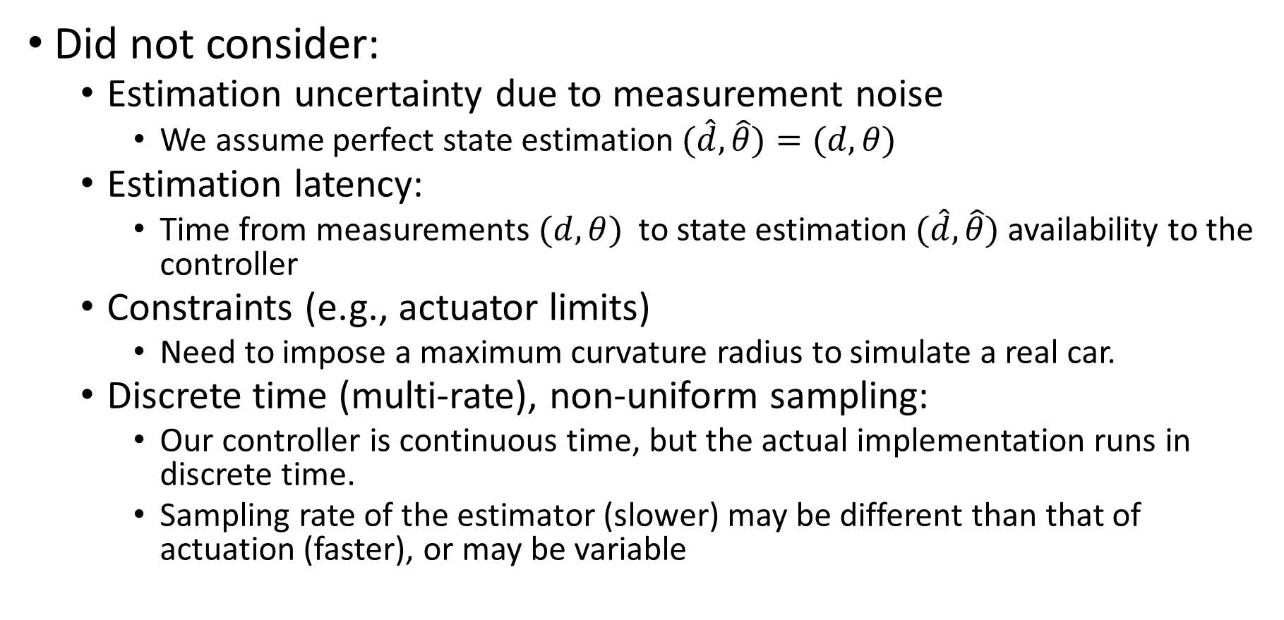
Simplifying Assumptions
Did not consider:
  Estimation uncertainty due to measurement noise
    We assume perfect state estimation $(\hat{d}, \hat{θ})=(d, θ)$
  Estimation latency:
    Time from measurements $(d, θ)$ to state estimation $(\hat{d}, \hat{θ})$ availability to the controller
  Constraints (e.g., actuator limits)
    Need to impose a minimum turning radius (maximum curvature) to simulate a real car.
  Discrete time (multi-rate), non-uniform sampling:
    Our controller is continuous time, but the actual implementation runs in discrete time.
    Sampling rate of the estimator (slower) may be different than that of actuation (faster), or may be variable

Slide 16
Outline
PID Control
LQR (Linear Quadratic Regulator)
MPC Control
Kinematic bicycle model
Geometric path tracking: Pure Pursuit & Stanley
Twiddle() for PID control tuning

Slide 17
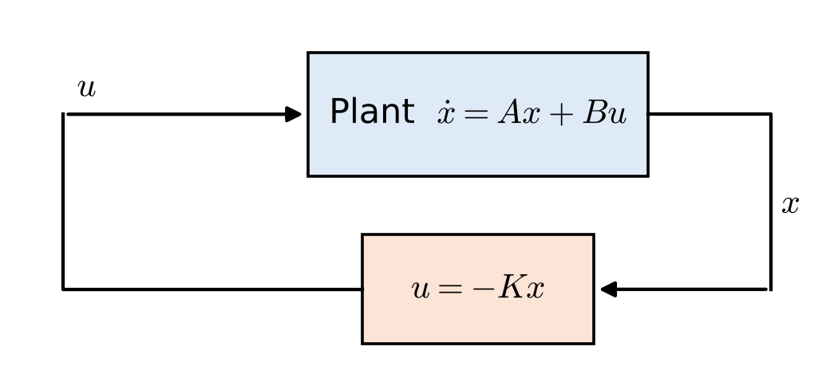
LQR: Linear Quadratic Regulator
Linear plant (discrete time): $x_{k+1}=Ax_{k}+Bu_{k}$
Drive the state to zero at minimum cost:
  $J=\sum_{k=0}^{∞}{\left(x_{k}^{⊤}Qx_{k}+u_{k}^{⊤}Ru_{k}\right)}$
  $Q≽0$ penalizes state error; $R≻0$ penalizes control effort (steering)
Optimal control is a linear state feedback: $u_{k}=−Kx_{k}, K={\left(R+B^{⊤}PB\right)}^{−1}B^{⊤}PA$
  $P$ solves the discrete algebraic Riccati equation (DARE):
  $P=Q+A^{⊤}PA−A^{⊤}PB {\left(R+B^{⊤}PB\right)}^{−1}B^{⊤}PA$
Continuous time $\dot{x}=Ax+Bu$: $K=R^{−1}B^{⊤}P$, with $P$ from $A^{⊤}P+PA−PBR^{−1}B^{⊤}P+Q=0$
K is computed offline; online control is one matrix–vector product
Design knobs
Q: how much each state error hurts
R: how expensive control is
No pole locations to choose by hand
Tools: scipy.linalg.solve_continuous_are, python-control lqr(), MATLAB lqr()
Notes:
LQR = Linear system, Quadratic cost, Regulator (drive the state to zero). The designer does not place poles by hand; instead chooses how much to penalize state error (Q) versus control effort (R), and the Riccati equation returns the optimal gain K. For a time-invariant plant K is constant, so it can be computed offline (scipy.linalg.solve_discrete_are / solve_continuous_are, python-control lqr, MATLAB lqr/dlqr). Note that the MPC slides later use the same cost with a finite horizon; with no constraints and an infinite horizon, MPC reduces to LQR.

Slide 18
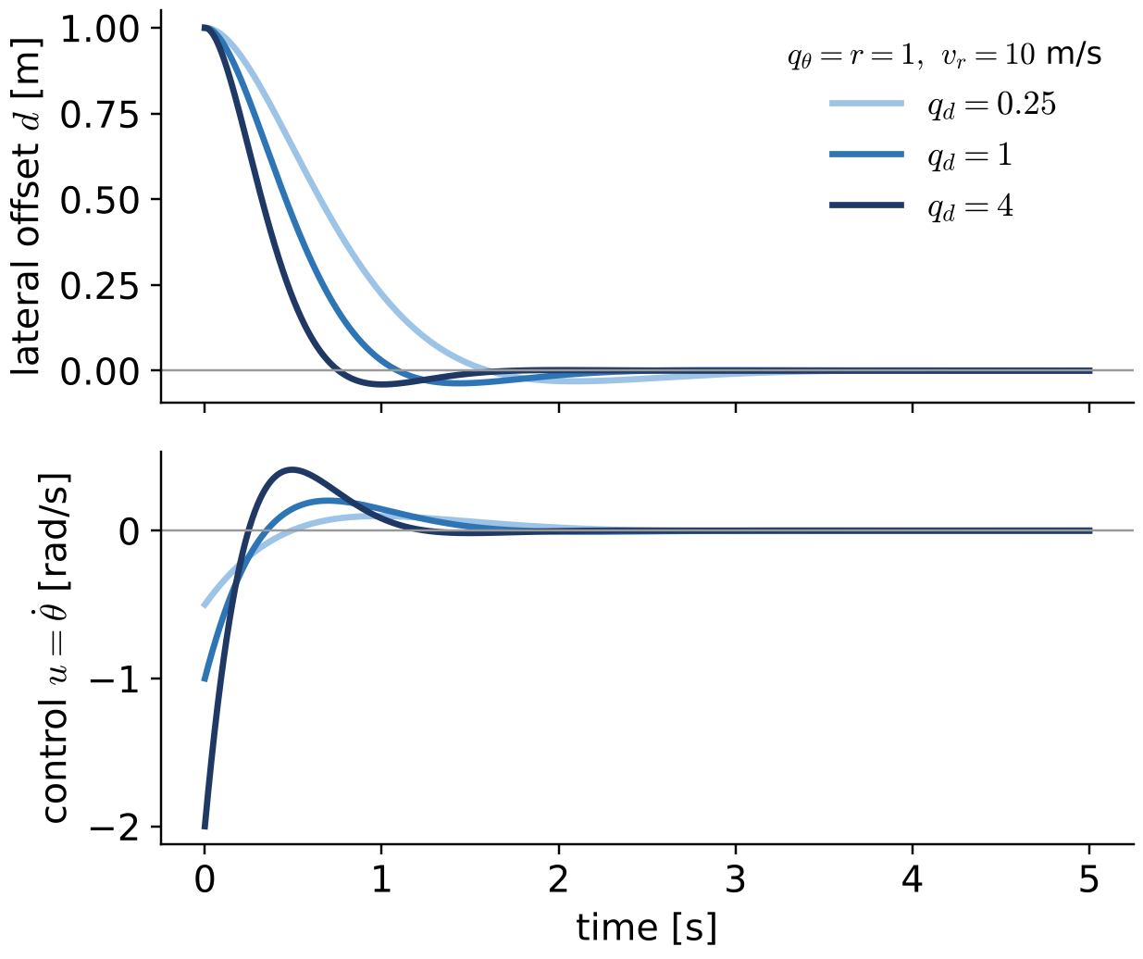
LQR Example: Lateral Control
Lateral model (slides 11–12): state $x={\left[d,θ\right]}^{⊤}$, control $u=\dot{θ}$
  $\dot{x}=\left[\begin{matrix}0 & v_{r} \\ 0 & 0\end{matrix}\right]x+\left[\begin{matrix}0 \\ 1\end{matrix}\right]u$
Cost with $Q=diag\left(q_{d},q_{θ}\right), R=r$: $J=\int_{0}^{∞}{\left(q_{d}d^{2}+q_{θ}θ^{2}+ru^{2}\right)}dt$
Solving the CARE gives closed-form gains for $u=K_{d}d+K_{θ}θ$:
  $K_{d}=−\sqrt{q_{d}/r}, K_{θ}=−\sqrt{q_{θ}/r+2v_{r}\sqrt{q_{d}/r}}$
Same form as the P controller on slide 12; poles from $λ^{2}−K_{θ}λ−v_{r}K_{d}=0$ — gains are always negative, so always stable
Steering command from $u=\dot{θ}=v_{r}tanδ/L$: $δ=arctan\left(Lu/v_{r}\right)$
Example: $v_{r}=10$ m/s, $q_{d}=q_{θ}=r=1$: $K_{d}=−1, K_{θ}=−\sqrt{21}≈−4.58$; poles $−2.29±2.18j$
Notes:
Using the same linearized lateral model as the pole-placement slides, the continuous-time Riccati equation can be solved by hand. With P = [[p11,p12],[p12,p22]] and R = r: the (1,1) entry gives p12 = sqrt(q_d r); the (2,2) entry gives p22 = sqrt(r q_theta + 2 v_r r p12); K = (1/r) B^T P = [p12/r, p22/r], and u = -K x. So K_d = -sqrt(q_d/r) and K_theta = -sqrt(q_theta/r + 2 v_r sqrt(q_d/r)). The closed-loop characteristic polynomial is lambda^2 - K_theta lambda - v_r K_d, exactly the polynomial on the pole-placement slide, so LQR is a systematic way of choosing K_d and K_theta. Numerical check (v_r = 10 m/s, q_d = q_theta = r = 1): K = [-1, -4.583], poles -2.29 +/- 2.18j. Increasing q_d increases |K_d| and the initial steering effort (right plots). The model uses heading rate u as the control; the steering angle follows from theta_dot = v tan(delta)/L.

Slide 19
LQR: Tuning and Trade-offs
Choosing Q, R (Bryson’s rule): $Q_{ii}=1/{\left(x_{i,max}\right)}^{2}$, $R_{jj}=1/{\left(u_{j,max}\right)}^{2}$; then tune in simulation
vs. pole placement: LQR picks the poles that minimize $J$; stable and robust (full-state feedback: ≥ 60° phase margin)
vs. MPC: LQR = unconstrained infinite-horizon MPC; constraints (steering angle/rate) are handled only by clipping $u$
In practice: schedule gains with speed, $K=K\left(v_{r}\right)$; add curvature feedforward $u_{ff}=v_{r}κ$
Used in AD: Apollo’s lateral controller is LQR-based, with 4 states (lateral error, its rate, heading error, its rate)
Change | Effect
Larger Q | Faster convergence; larger steering effort; more noise sensitivity
Larger R | Gentler steering; slower convergence; larger tracking error
Design recipe
1. Linearize the model: A, B
2. Choose Q, R (Bryson’s rule)
3. Solve the Riccati equation → K
4. Simulate; adjust Q, R; schedule K over speed
5. Add feedforward; clip u to actuator limits
Source: Apollo documentation, “How to Tune Control Parameters”
Notes:
Bryson's rule is a starting point: normalize each state/input by the largest acceptable deviation. The robustness statement (phase margin of at least 60 degrees, gain margin from 1/2 to infinity) holds for continuous-time full-state-feedback LQR with R > 0; it does not carry over automatically once an observer is added (LQG). LQR is the unconstrained, infinite-horizon limit of the linear MPC on slide 20 (u = -Kx). Apollo's lateral controller: 'The lateral controller is an LQR-based optimal controller' with four states: lateral error, lateral error rate, heading error, heading error rate (Apollo documentation, How to Tune Control Parameters).

Slide 20
Outline
PID Control
LQR (Linear Quadratic Regulator)
MPC Control
Kinematic bicycle model
Geometric path tracking: Pure Pursuit & Stanley
Twiddle() for PID control tuning

Slide 21
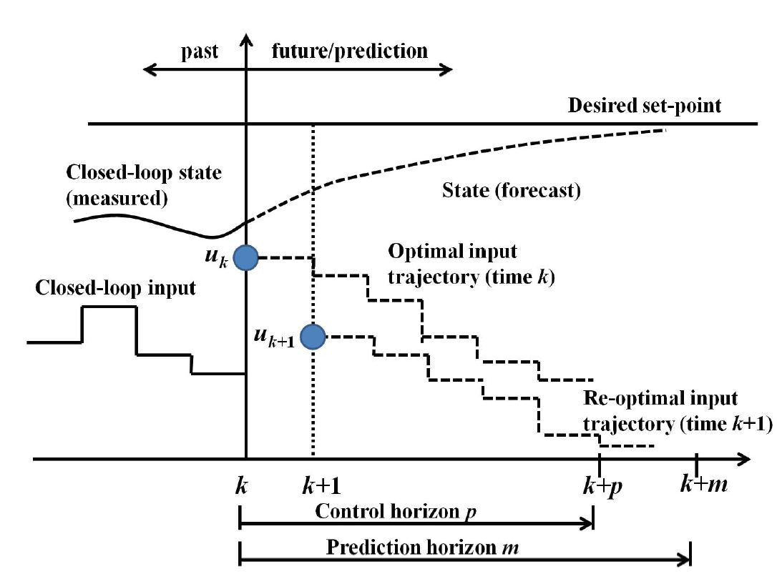
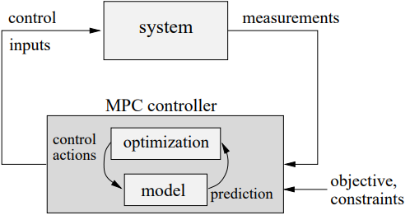
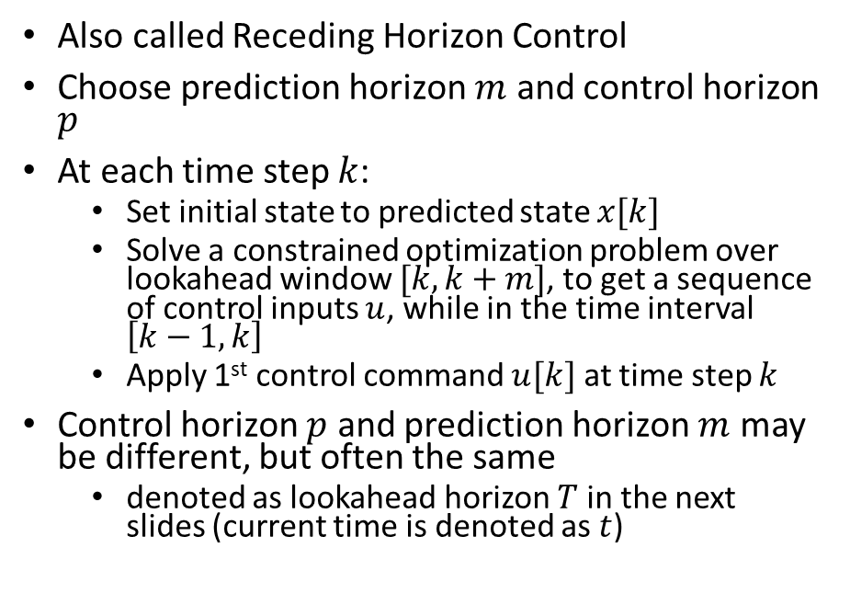
MPC (Model-Predictive Control)
Also called Receding Horizon Control
Choose prediction horizon $m$ and control horizon $p$
At each time step $k$:
  Set initial state to the current (measured/estimated) state $x[k]$
  Solve a constrained optimization problem over lookahead window $[k,k+m]$, to get a sequence of control inputs $u$, while in the time interval $\left[k−1,k\right]$
  Apply 1st control command $u[k]$ at time step $k$
Control horizon $p$ and prediction horizon $m$ may be different, but often the same
  denoted as lookahead horizon $T$ in the next slides (current time is denoted as $t$)

Slide 22
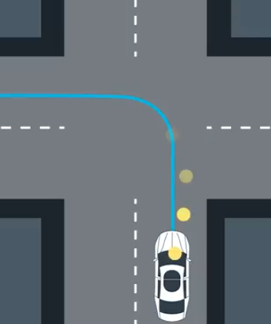
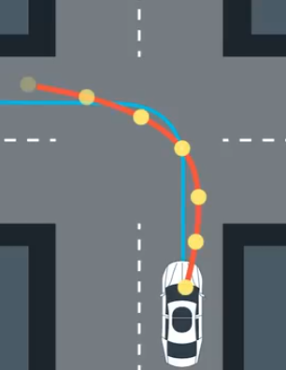
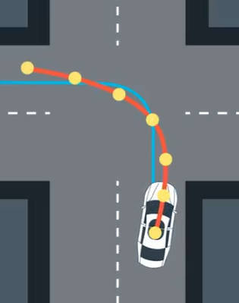
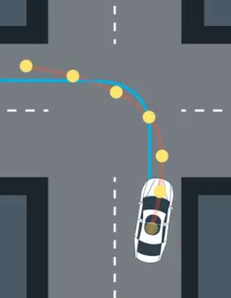
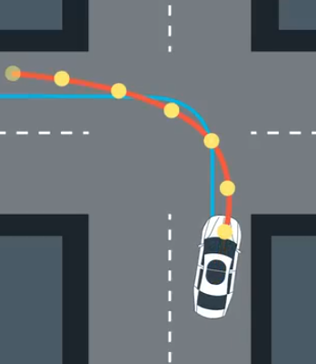


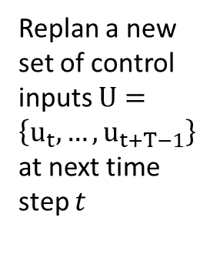

MPC Example
Solve for opt control inputs $U=\left\{u_{t},…,u_{t+T−1}\right\}$ within lookahead horizon $T$ to track the blue desired traj
Execute control input $u_{t}$
at 1st timestep
Execute control input $u_{t}$ at 1st timestep
Replan a new set of control inputs $U=\left\{u_{t},…,u_{t+T−1}\right\}$ at next time step $t$
…
Notes:
Input trajectory refers to computed control inputs $U=\left\{u_{k},…,u_{k+p−1}\right\}$

Slide 23
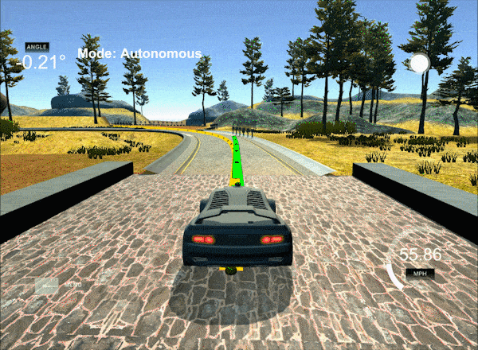
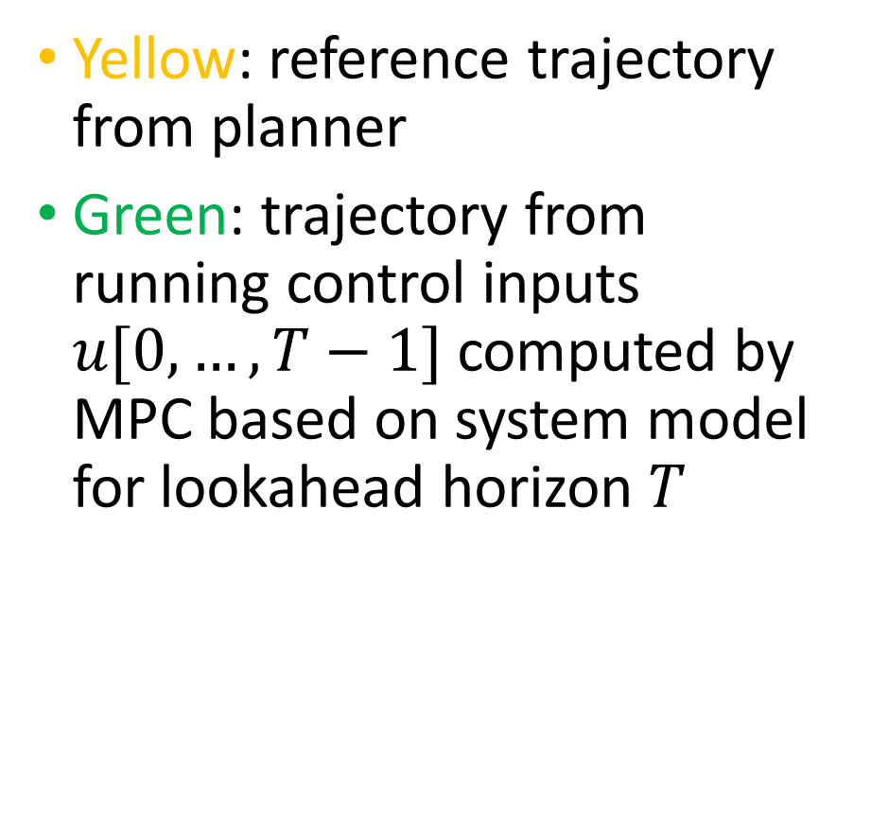
MPC Illustration Con’t
Yellow: reference trajectory from planner
Green: trajectory from running control inputs $u[0,…,T−1]$ computed by MPC based on system model for lookahead horizon $T$
https://medium.com/@david010/vehicle-mpc-controller-33ae813cf3be

Slide 24
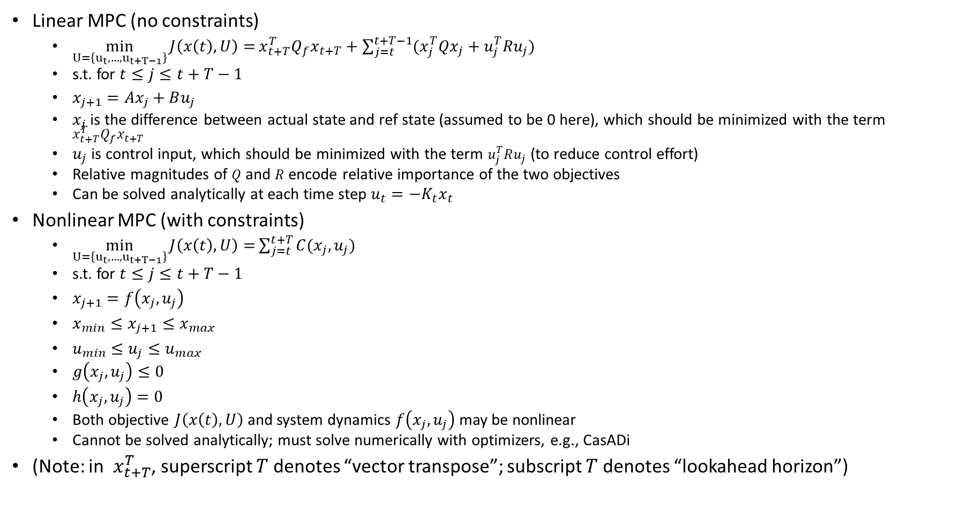
Linear vs. Nonlinear MPC
Linear MPC (no constraints)
  $\min_{U=\left\{u_{t},…,u_{t+T−1}\right\}}{J\left(x\left(t\right),U\right)=}x_{t+T}^{T}Q_{f}x_{t+T}+\sum_{j=t}^{t+T−1}{(x_{j}^{T}Qx_{j}}+u_{j}^{T}Ru_{j})$
  s.t. for $t≤j≤t+T−1$
  $x_{j+1}=Ax_{j}+Bu_{j}$
  $x_{j}$ is the difference between actual state and ref state (assumed to be 0 here), which should be minimized with the term $x_{t+T}^{T}Q_{f}x_{t+T}$
  $u_{j}$ is control input, which should be minimized with the term $u_{j}^{T}Ru_{j}$ (to reduce control effort)
  Relative magnitudes of $Q$ and $R$ encode relative importance of the two objectives
  Can be solved analytically at each time step $u_{t}=−K_{t}x_{t}$
Nonlinear MPC (with constraints)
  $\min_{U=\left\{u_{t},…,u_{t+T−1}\right\}}{J\left(x\left(t\right),U\right)=}\sum_{j=t}^{t+T−1}{C(x_{j},u_{j}) }+C_{f}\left(x_{t+T}\right)$
  s.t. for $t≤j≤t+T−1$
  $x_{j+1}=f\left(x_{j},u_{j}\right)$
  $x_{min}≤x_{j+1}≤x_{max}$
  $u_{min}≤u_{j}≤u_{max}$
  $g\left(x_{j},u_{j}\right)≤0$
  $h\left(x_{j},u_{j}\right)=0$
  Both objective $J\left(x\left(t\right),U\right)$and system dynamics $f\left(x_{j},u_{j}\right)$ may be nonlinear
  Cannot be solved analytically; must solve numerically with optimizers, e.g., CasADi
(Note: in $x_{t+T}^{T}$, superscript $T$ denotes “vector transpose”; subscript $T$ denotes “lookahead horizon”)

Slide 25
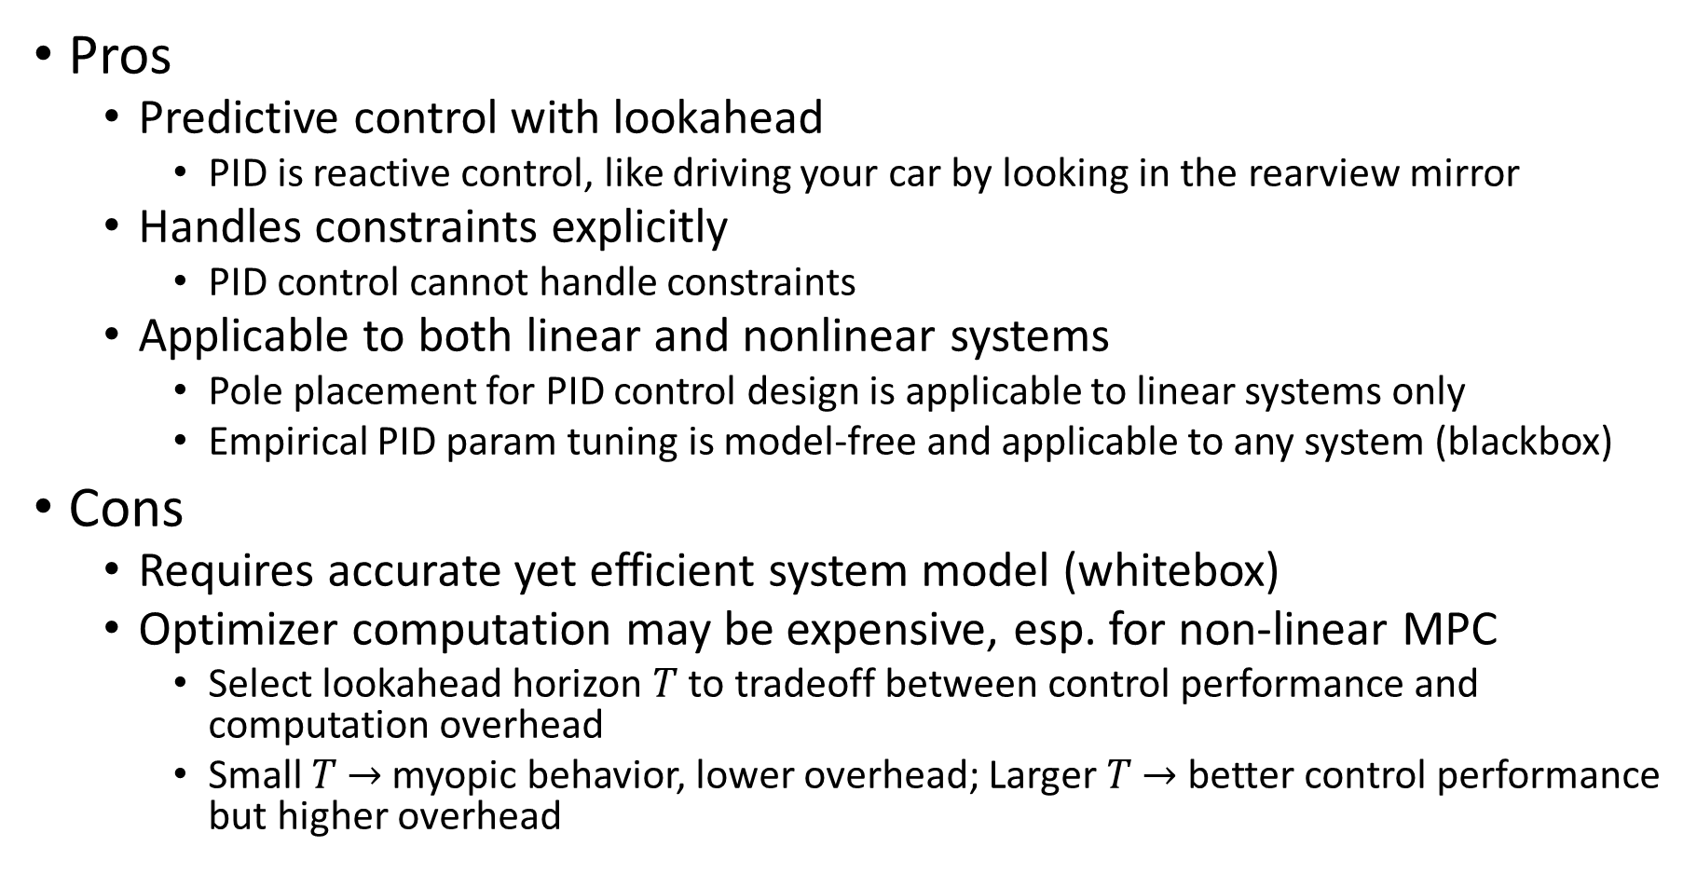
MPC Pros and Cons
Pros
  Predictive control with lookahead
    PID is reactive control, like driving your car by looking in the rearview mirror
  Handles constraints explicitly
    PID control cannot handle constraints
  Applicable to both linear and nonlinear systems
    Pole placement for PID control design is applicable to linear systems only
    Empirical PID param tuning is model-free and applicable to any system (blackbox)
Cons
  Requires accurate yet efficient system model (whitebox)
  Optimizer computation may be expensive, esp. for non-linear MPC
    Select lookahead horizon $T$ to tradeoff between control performance and computation overhead
    Small $T$ $→$myopic behavior, lower overhead; Larger $T$ $→$ better control performance but higher overhead
Notes:
Pole placement for PID control design is applicable to linear systems only

Slide 26
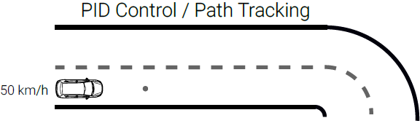
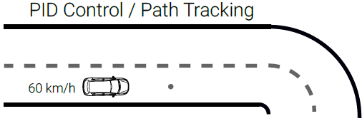
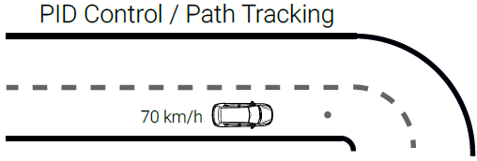


PID Control Example (No Look-Ahead)
Vehicle accelerates to track setpoint speed of 70 km/h
Then decelerates upon encountering a sharp turn, but it is too late and cannot track the lane
https://uni-tuebingen.de/fakultaeten/mathematisch-naturwissenschaftliche-fakultaet/fachbereiche/informatik/lehrstuehle/autonomous-vision/lectures/self-driving-cars/

Slide 27





MPC Control Example (Look-Ahead)
MPC computes control actions based on a lookahead window into the future
Vehicle decelerates early in anticipation of the sharp turn
https://uni-tuebingen.de/fakultaeten/mathematisch-naturwissenschaftliche-fakultaet/fachbereiche/informatik/lehrstuehle/autonomous-vision/lectures/self-driving-cars/

Slide 28

MPC Quiz
Which of the statements below about MPC are true?
  1) Horizon is a finite window of time
  2) Prediction horizon keeps being shifted at each time step
  3) Full optimization over the time horizon is performed at each iteration
  4) Only the first control action from the optimization is applied at time $t$
  5) All of the above
ANS: 5

Slide 29
Outline
PID Control
LQR (Linear Quadratic Regulator)
MPC Control
Kinematic bicycle model
Geometric path tracking: Pure Pursuit & Stanley
Twiddle() for PID control tuning

Slide 30

Kinematics vs. Dynamics
Kinematics is study of motion without considering the forces that affect the motion. It deals with the geometric relationships that govern the system
  A kinematic model: $\dot{x}=v, \dot{v}=\ddot{x}=a$
  Uses position, velocity, acceleration (and/or further derivatives) as control input (e.g. the kinematic bicycle model)
Dynamics is the study of motion taking into account the forces that affect it. It is described by the equations of motion.
  A dynamic model: $F=M\ddot{x}+B\dot{x}=Ma+Bv$ (Newton’s law with friction)
  Uses force and torque as control input, and takes mass and inertia into consideration.
  e.g., vehicle dynamics model (longitudinal and lateral)
Consider two vehicles with the same geometry but different mass/weight turning a tight corner
  They may have the same kinematic model, but different dynamic model due to different mass $M$.
  Both may be controllable kinematically by control input $a$
    The light vehicle may be controllable dynamically by control input $F$.
    The heavy vehicle may not be controllable dynamically by control input $F$. Due to large $M$, $F$ may exceed the max actuator limit.
Orthogonal issue from control algorithm
  Control algorithms, e.g., PID or MPC, may be either kinematic or dynamic control

Slide 31


Kinematic vs. Dynamic Control
PID controller for kinematic bicycle model with heading angle rate $(\dot{θ})$ and velocity $(v_{r}$, constant here) as control input. ($\dot{θ}$ should be controlled indirectly by controlling steering angle $δ$, with $\dot{θ}=\frac{v\tan{δ}}{L}$.)
MPC for dynamic vehicle model (high-level controller) with forces (longitudinal and lateral) as control input.

Slide 32







Kinematic Bicycle Model
Front wheel steering. Assuming here rear wheel as reference point (may also use front wheel or center of gravity).
State vector: ${\left[\begin{matrix}x & y & θ\end{matrix}\right]}^{T}$: vehicle pose includes its position $(x,y)$ and heading angle $θ$.
Control inputs: ${\left[\begin{matrix}δ & v\end{matrix}\right]}^{T}$: steering angle $δ$ and vehicle speed $v$ (assumed to be constant).
$\tan{δ}=\frac{L}{R}$
  $L$: vehicle length (distance between 2 wheels); $R$: rotation radius of Instantaneous Center of Rotation (ICR), equal to distance between ICR and rear wheel. Curvature $κ=\frac{1}{R}$.
  Line from ICR to each wheel is perpendicular to it.
$\dot{θ}=ω=\frac{v}{R}=\frac{v\tan{δ}}{L}$
  Angular velocity is speed $v$ divided by rotation radius $R$
Typically, angles $δ,θ$ are based on counter-clockwise convention w.r.t reference direction.
  In the fig, $δ≈\frac{π}{6}$ w.r.t ref direction $v$; $θ≈\frac{π}{6}$ w.r.t ref direction east (horizontal); $\dot{θ}>0$ for counter-clockwise rotation.
$$π/2$$
$$π/2$$
$$(x,y)$$
$$\left[\dot{\begin{matrix}x \\ \dot{y} \\ \dot{θ}\end{matrix}}\right]=v\left[\begin{matrix}\cos{θ} \\ \sin{θ} \\ \frac{\tan{δ}}{L}\end{matrix}\right]$$
(Non-linear in $δ$;
Linear in $v$)

Slide 33








State Update in Python Code
# apply noise
steering2 = random.gauss(steering, self.steering_noise)
distance2 = random.gauss(distance, self.distance_noise)
# apply steering drift
steering2 += self.steering_drift
# noise and drift are all set to 0, so steering2 is steering angle $δ$, distance2 is distance traveled per time step $vdt$
# Execute motion
turn = np.tan(steering2) * distance2 / self.length ($\dot{θ}dt=\frac{vdt tan{δ}}{L}$)
if abs(turn) < tolerance: (with small $\dot{θ}dt$)
# approximate by straight line motion
self.x += distance2 * np.cos(self.orientation) ($x+=vdt\cos{θ}$)
self.y += distance2 * np.sin(self.orientation) ($y+=vdt\sin{θ}$)
self.orientation = (self.orientation + turn) % (2.0 * np.pi) ($θ=(θ+\dot{θ}dt$)%($2π$))
else: (with large $\dot{θ}dt$)
# Circular motion around ICR
radius = distance2 / turn ($R=\frac{v}{\dot{θ}}$; can also use $R=\frac{L}{\tan{δ}}$)
# compute ICR’s coordinates (cx, cy)
cx = self.x - (np.sin(self.orientation) * radius) ($cx=x−R\sin{θ}$)
cy = self.y + (np.cos(self.orientation) * radius) ($cy=y+R\cos{θ}$)
self.orientation = (self.orientation + turn) % (2.0 * np.pi) ($θ=(θ+\dot{θ}dt\text{)\%(}2π\text{)}$)
# compute vehicle’s x, y coordinate after rotation around ICR
self.x = cx + (np.sin(self.orientation) * radius) ($x=cx+R\sin{θ}$)
self.y = cy - (np.cos(self.orientation) * radius) ($y=cy−R\cos{θ}$)
$$(cx,cy)$$
$$θ$$
$$R\cos{θ}$$
$\%(2π)$ (modulo $2π$) keeps angles to be within $2π$; It can be omitted since it does not affect results of $cos,sin$ functions (assuming no numeric overflow).
$$−R\sin{θ}$$
$$(x,y)$$

Slide 34

State Update Equation
Circular motion around ICR (accurate):
$\left[\begin{matrix}x(t+dt) \\ y\left(t+dt\right) \\ θ(t+dt)\end{matrix}\right]=\left[\begin{matrix}x(t)−R\sin{θ}+R\sin{(θ}+\dot{θ}dt) \\ y\left(t\right)+R\cos{θ}−R\cos{(θ}+\dot{θ}dt) \\ θ+\dot{θ}dt\end{matrix}\right]$
  $R=\frac{L}{\tan{δ}}=\frac{v}{\dot{θ}}$
Straight-line motion for small $\dot{θ}dt$ (approximate):
$\left[\begin{matrix}x(t+dt) \\ y\left(t+dt\right) \\ θ(t+dt)\end{matrix}\right]=\left[\begin{matrix}x\left(t\right)+vdt\cos{θ} \\ y\left(t\right)+vdt\sin{θ} \\ θ+\dot{θ}dt\end{matrix}\right]$
  $δ→0,\dot{θ}dt→0$

Slide 35

Straight Line vs. Circular Motion
Straight line motion (with steering angle $δ=0$) is a special case of circular motion with radius $∞$.
  $δ→0⇒R=\frac{L}{\tan{δ}}→∞,\dot{θ}=\frac{v}{R}→0$ (small steering angle $δ$ leads to slow angular velocity $\dot{θ}$.)
  We use this special case to improve computational efficiency for small $δ,\dot{θ}$, and avoid division by 0.
$x(t+dt)=x(t)−R\sin{θ}+R\sin{(θ}+\dot{θ}dt)=x+R(\sin{(θ}+\dot{θ}dt)−sin⁡θ)=x+\frac{v}{\dot{θ}}∗\cos{θ}∗\dot{θ}dt= x+vdt\cos{θ}$
  $\sin{(θ}+\dot{θ}dt)−\sin{θ}≈\frac{d}{dt}\sin{θ}∗\dot{θ}dt=\cos{θ}∗\dot{θ}dt$, for small $\dot{θ}dt$.
$y\left(t+dt\right)=y\left(t\right)+R\cos{θ}−R\cos{(θ}+\dot{θ}dt)=y−R(\cos{(θ}+\dot{θ}dt)−cos⁡θ)=y+\frac{v}{\dot{θ}}∗\sin{θ}∗\dot{θ}dt=y+vdt\sin{θ}$
  $\cos{(θ}+\dot{θ}dt)−\cos{θ}≈\frac{d}{dt}\cos{θ}∗\dot{θ}dt=−\sin{θ}∗\dot{θ}dt$, for small $\dot{θ}dt$.
Four special cases of straight line motion:
  $θ=0⇒x^{′}=x+vdt,y^{′}=y$ (east)
  $θ=π⇒x^{′}=x−vdt,y^{′}=y$ (west)
  $θ=\frac{π}{2}⇒x^{′}=x,y^{′}=y+vdt$ (north)
  $θ=\frac{3π}{2}⇒x^{′}=x,y^{′}=y−vdt$ (south)

Slide 36
Outline
PID Control
LQR (Linear Quadratic Regulator)
MPC Control
Kinematic bicycle model
Geometric path tracking: Pure Pursuit & Stanley
Twiddle() for PID control tuning

Slide 37

Pure Pursuit: Geometry
Geometric tracker (Coulter, CMU 1992): steer along the circular arc through a goal point on the path, one lookahead distance $L_{d}$ ahead
Reference point: rear axle; kinematic bicycle model with wheelbase $L$ (slide 28)
$α$: angle between vehicle heading and the line to the goal point
The arc is tangent to the heading at the rear axle; the chord $L_{d}=2Rsinα$, so
  $R=\frac{L_{d}}{2sinα}, κ=\frac{1}{R}=\frac{2sinα}{L_{d}}$
Steering from $tanδ=L/R$ (slide 28):
  $δ=arctan\left(\frac{2Lsinα}{L_{d}}\right)$
Example: $L=2.5$ m, $L_{d}=5$ m, $α={20}^{∘}$ ⇒ $κ=0.137 m^{−1}$ (R = 7.3 m), $δ={18.9}^{∘}$
Intuition: like a driver steering toward a point a little way down the road
Notes:
Pure pursuit (R. C. Coulter, 'Implementation of the Pure Pursuit Path Tracking Algorithm', CMU-RI-TR-92-01, 1992). The vehicle is modelled with the kinematic bicycle model of slide 28 (reference point = rear axle). The circle through the rear axle that is tangent to the current heading and passes through the goal point has radius R. In the isosceles triangle formed by the centre of the circle, the rear axle and the goal point, the chord L_d subtends the central angle 2*alpha (tangent-chord angle theorem), hence L_d = 2 R sin(alpha). With tan(delta) = L/R this gives delta = arctan(2 L sin(alpha)/L_d). Numerical example: L = 2.5 m, L_d = 5 m, alpha = 20 deg: kappa = 2 sin(20 deg)/5 = 0.137 1/m, R = 7.31 m, delta = arctan(0.342) = 18.9 deg.

Slide 38

Pure Pursuit: Lookahead Distance
Goal point in the vehicle frame $\left(x_{g},y_{g}\right)$: $sinα=y_{g}/L_{d}$ ⇒ $κ=\frac{2y_{g}}{L_{d}^{2}}$
  Proportional control of the goal point’s lateral offset, gain $2/L_{d}^{2}$
Lookahead grows with speed: $L_{d}=k_{v} v+L_{0}$
  Small $L_{d}$: tight tracking, but oscillation and noise sensitivity
  Large $L_{d}$: smooth and stable, but cuts corners: error ≈ $L_{d}^{2}/\left(8R_{path}\right)$
Each cycle: (1) path → vehicle frame; (2) goal point = first path point ≥ $L_{d}$ away; (3) $α=atan2\left(y_{g},x_{g}\right)$, $δ=atan2\left(2Lsinα,L_{d}\right)$; (4) clip δ to the steering limit
No tire/dynamics model: good at low–medium speed. Autoware offers pure pursuit as an alternative lateral controller (default: MPC)
Simulated peak error (v = 5 m/s, R = 20 m corner): L_d = 2 m → 0.02 m; 5 m → 0.13 m; 10 m → 0.55 m
Notes:
With the goal point expressed in the vehicle frame (x forward, y left), sin(alpha) = y_g / L_d, so the curvature command is kappa = 2 y_g / L_d^2: a proportional controller on the lateral offset of the goal point whose gain falls with the square of the lookahead distance. The lookahead distance is the single tuning parameter; it is usually made speed dependent, L_d = k_v v + L_0. On a circular path of radius R_path the arc through the rear axle and the goal point stays inside the path by roughly L_d^2/(8 R_path): the plot (v = 5 m/s, 90-degree corner with R_path = 20 m) shows peak errors of about 0.02 m, 0.13 m and 0.55 m for L_d = 2, 5 and 10 m (approximation: 0.025, 0.16, 0.63 m). Autoware: the lateral controller is selected with lateral_controller_mode; default mpc, alternative pure_pursuit (Autoware documentation, Control launch).

Slide 39

Stanley Controller
Controller of Stanford’s DARPA Grand Challenge winner “Stanley” (Hoffmann et al., 2007)
Reference point: front axle. Two errors:
  Heading error $ψ$: path tangent direction − vehicle heading
  Cross-track error $e$: signed distance from the front axle to the nearest path point (positive if the path is on the left)
Steering law:
  $δ=ψ+arctan\left(\frac{k e}{v}\right)$
  1st term: align the wheels with the path; 2nd term: steer toward the path, more for large $e$, less at high speed $v$
Practical version: $arctan\left(\frac{k e}{k_{s}+v}\right)$ (no division by zero at standstill); clip $δ$ to the steering limit
Example: $k=1 s^{−1}, v=5, e=0.5, ψ=0.1$ ⇒ $δ=0.1+arctan\left(0.1\right)≈{11.4}^{∘}$
Sign convention
ψ = path heading − vehicle heading
e > 0 if the path is on the left of the front axle
δ > 0 steers left, so both terms steer toward the path
Notes:
Stanley (G. M. Hoffmann, C. J. Tomlin, M. Montemerlo, S. Thrun, 'Autonomous Automobile Trajectory Tracking for Off-Road Driving: Controller Design, Experimental Validation and Racing', ACC 2007; the vehicle is described in Thrun et al., 'Stanley: The robot that won the DARPA Grand Challenge', JFR 2006). Sign convention: psi = path heading minus vehicle heading, e positive when the path is to the left of the front axle, delta positive = steer left, so both terms steer toward the path. Numerical example: k = 1/s, v = 5 m/s, e = 0.5 m, psi = 0.1 rad: arctan(k e / v) = arctan(0.1) = 0.0997 rad, delta = 0.1997 rad = 11.4 deg. MATLAB's lateralControllerStanley implements the same law; its PositionGain is the gain k.

Slide 40

Stanley: Why It Converges
Wheel direction relative to the path is $arctan\left(ke/v\right)$; plugging into the kinematic model:
  $\dot{e}=−vsin\left(arctan\frac{ke}{v}\right)=−\frac{k e}{\sqrt{1+{\left(ke/v\right)}^{2}}}$
Small error: $\dot{e}≈−k e$ ⇒ $e\left(t\right)≈e\left(0\right) e^{−kt}$
  Exponential convergence, time constant $1/k$, independent of speed
Large error: $\left|\dot{e}\right|→v$: wheels point toward the path
Tuning: larger $k$ converges faster but can oscillate with steering lag and rate limits
Assumes kinematic model, no slip, no saturation. The published version adds yaw-rate and steering-angle damping terms
vs. Pure Pursuit: Stanley has no lookahead (front axle, feedback on e and ψ); pure pursuit looks ahead by L_d
Notes:
With the steering law delta = psi + arctan(k e / v), the front wheel makes the angle arctan(k e / v) with the path, so the lateral velocity of the front axle is de/dt = -v sin(arctan(k e / v)) = -k e / sqrt(1 + (k e / v)^2) (using sin(arctan x) = x / sqrt(1 + x^2)). For |k e| << v this is de/dt = -k e, i.e. exponential convergence with rate k regardless of speed; for large e it saturates at -v. The plot integrates this ODE for k = 1/s and e(0) = 2 m at v = 2, 5, 10 m/s together with the pure exponential: the curves are nearly identical except for the slower start at v = 2 m/s where the nonlinear term matters. Hoffmann et al. additionally include yaw-rate damping and steering-angle damping terms in the controller actually used on the vehicle.

Slide 41

Pure Pursuit vs. Stanley vs. LQR
Kinematic bicycle, v = 6 m/s, start 1.5 m off the path, 90° corner (R = 20 m). Pure Pursuit: L_d = 4.5 m; Stanley: k = 1.5 s⁻¹; LQR: q_d = q_θ = r = 1 + curvature feedforward
Peak error in the corner: Pure Pursuit 0.11 m, Stanley 0.02 m, LQR 0.01 m (0.30 m without feedforward). Peak steering: LQR hits the 30° limit at the start
Notes:
Kinematic bicycle model (L = 2.5 m, steering limit 30 deg) driven at v = 6 m/s, rear-axle reference for pure pursuit and LQR, front-axle reference for Stanley. Path: 20 m straight, then a 90-degree left corner of radius 20 m, then straight. The vehicle starts 1.5 m to the right of the path with heading aligned with the path. Pure pursuit: L_d = 0.5 v + 1.5 = 4.5 m. Stanley: k = 1.5 1/s, k_s = 1 m/s. LQR: q_d = q_theta = r = 1 (K = [1.0, 3.61] at 6 m/s) with curvature feedforward. Peak cross-track error inside the corner: pure pursuit 0.11 m, Stanley 0.02 m, LQR 0.01 m. LQR without curvature feedforward has a steady offset of about 0.30 m in the corner. LQR saturates the 30-degree steering limit at the start because of the 1.5 m initial offset; the peak steering angle is 20 deg for pure pursuit and 18 deg for Stanley.

Slide 42
Choosing a Lateral Controller
Controller | Reference point | Model needed | Constraints | Strengths | Weaknesses
PID | Error signals (d, θ) | None (tuned, e.g. twiddle) | Clip only | Simple, model-free | Gains depend on speed; no preview
Pure Pursuit | Rear axle | Kinematic geometry | Clip δ | Robust, one parameter (L_d) | Cuts corners; L_d trade-off
Stanley | Front axle | Kinematic geometry | Clip δ | Exponential error decay; good at moderate speed | No preview; noisy e, ψ at low speed
LQR | Full state (d, ḋ, θ, θ̇) | Linear error model | Clip u | Optimal trade-off via Q, R; speed-scheduled gains (Apollo) | Model mismatch; no explicit constraints
MPC | Predicted horizon | Kinematic or dynamic model | Explicit | Constraints + preview (Autoware default) | Computation; needs accurate model
Notes:
Summary of the lateral controllers covered in this lecture. Pure pursuit and Stanley are geometric controllers that need only the kinematic bicycle geometry; LQR needs a linear error model and a cost; MPC adds a prediction horizon and explicit constraints at the price of computation. In open-source stacks: Apollo's lateral controller is LQR-based; Autoware's default lateral controller is MPC with pure pursuit as an alternative.

Slide 43
PID Control Lab Setup
Based on Udacity course Lesson AI for Robotics, Lesson 15: PID Control
Lateral control of a car to run along a race track (either straight line or circular) with fixed speed.

Slide 44
Outline
PID Control
LQR (Linear Quadratic Regulator)
MPC Control
Kinematic bicycle model
Geometric path tracking: Pure Pursuit & Stanley
Twiddle() for PID control tuning

Slide 45


Udacity: Racetrack Control
Lesson 16: Problem Set 5, 4. Quiz: Racetrack control.
Cross-track error (cte): lateral distance (of rear wheel) to desired trajectory, defined as:
  if $x∈[radius, 3∗radius]$: deviation from the straight horizontal track (with the implicit assumption that the car will not deviate from the track for more than $radius$.)
  Otherwise: deviation from each semi-circle track.
For clockwise traversal, cte>0 if car is outside of the track region; cte<0 if inside.
cte>0
cte>0
Initial pose
cte<0
cte<0

Slide 46


run()
Implements the PID controller for with PID gains
  params[0] as $K_{p}$; params[1] as $K_{d}$; params[2] as $K_{i}$.
  Returns actual trajectory as arrays of x_trajectory[], y_trajectory[]; and average error, defined as mean of squared cte
For clockwise travel direction:
  If cte>0, car is outside of track region; steering angle $δ$ should decrease (turn right according to the counter-clockwise convention)
  If cte<0, car is inside of track region; steering angle $δ$ should increase (turn left)
  Based on the above, $K_{p}$ should be positive (this can be a sanity check for your final solution)
This is for straight line track; need to call myrobot.cte() for circular track.
PID control law
Notes:
(Sign convention: if the minus signs are removed, they are absorbed into the gains, i.e., K_p < 0.)

Slide 47


For General $dt$
The Python code assumes controller time step size $dt=1$.
  Also, $v$ is constant. $δ$’s range is unconstrained (steering wheel can be turned to arbitrary angle).
For general $dt$, the following needs to be modified:
  Call myrobot.move(steer, speed*dt), to match its definition move(self, steering, distance,…)
  In the PID control law:
    Differential of error$diffcte=\frac{cte−prevcte}{dt}$
    Integral of error$intcte+=cte∗dt$

Slide 48





twiddle()
twiddle: “twist, move, or fiddle with (something), typically in a purposeless or nervous way” –Encyclopedia.
Adjust each $p\left[i\right]$ in turn.
Update $p\left[i\right]$ to $p\left[i\right]+dp[i]$ and run(). If error decreases, then $p\left[i\right]$ was updated in the right direction. Keep the update $+dp[i]$ to get $p\left[i\right]+dp[i]$, and increase step size to $1.1∗dp\left[i\right]$.
If error increases, then $p\left[i\right]$ was updated in the wrong direction. Update in the opposite direction by $−2∗dp[i]$ to get $p\left[i\right]−dp[i]$. Run again.
If error decreases, then $p\left[i\right]$ was updated in the right direction. Keep the current $p\left[i\right]−dp[i]$, and increase step size to $1.1∗dp\left[i\right]$.
If error increases, then $p\left[i\right]$ was updated in the wrong direction. Update in the opposite direction by +$dp[i]$ to get back the original $p\left[i\right]$ . Reduce step size to $.9∗dp\left[i\right]$.

Slide 49


Changing to P Control
Setting $dparams\left[1\right]=dparams\left[2\right]=0$ turns it into a P controller, since $K_{d},K_{i}$ are initialized to 0 and never changed. $K_{p}$ is adjusted in twiddle()
twiddle() is a local optimization algorithm, so perf is dependent on parameter initialization. Here the params (PID gains) are initialized to 0 for simplicity.
  https://classroom.udacity.com/courses/cs373/lessons/91f48b5b-a063-41f9-ace6-5fb9e7508941/concepts/b740218e-b0eb-40dc-80af-343912305293

Slide 50

twiddle() vs. Pole Placement
twiddle() is a model-free approach to tuning PID controller by coordinate descent (a gradient-free local search). It adjusts each PID gain parameter systematically, gradually decreasing or increasing step of adjustment $dp[i]$ (the step size, not a gradient) until convergence to a local minimum of best_err.
Pole placement for PID controller design is model-based, but requires a linear model
  $\left[\dot{\begin{matrix}x \\ \dot{y} \\ \dot{θ}\end{matrix}}\right]=v\left[\begin{matrix}\cos{θ} \\ \sin{θ} \\ \frac{\tan{δ}}{L}\end{matrix}\right]≈\left[\begin{matrix}v \\ vθ \\ u\end{matrix}\right]$
  With simplifying assumptions:
    $θ$ is small
    Simplified kinematic model: $u=\dot{θ}$ as control input instead of $δ$

